Slide 1
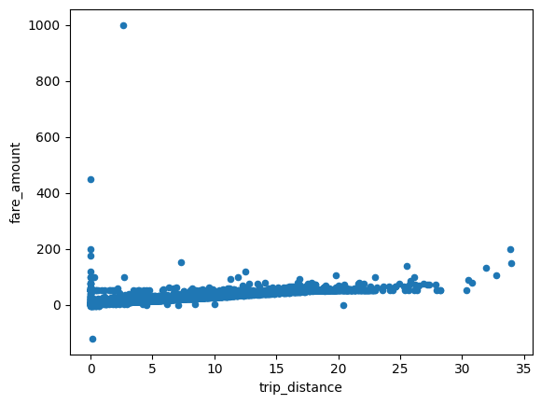
New York City TLC Project Preliminary Data Summary
Executive summary report
Commission Prepared by Automatidata
This project performed a preliminary inspection of NYC Taxi and Limousine Commission data to inform the team of key data variable descriptions, and ensure the information provided is suitable for generating clear and meaningful insights.
Explored dataset to find any unusual values.
Considered which variables are most useful to build predictive models (in this case: total_amount and trip_distance).
Considered potential interactions between the two chosen variables.
Examined which components of the provided data will provide relevant insights.
Built the groundwork for future exploratory data analysis, visualizations, and models.
This dataset includes variables that should be helpful for building prediction model(s) on taxi cab rides.
The identified unusual values are trips that are a short distance but have high charges associated with them, as shown in the total_amount variable. See screenshot.
Fare Amount VS Trip Distance
Conduct a complete exploratory data analysis.
Perform any data cleaning and data analysis steps to understand unusual variables (e.g., outliers).
Use descriptive statistics to learn more about the data.
Create and run a regression model.

